Slide 1
Regression Analysis
Logistic Regression
Nicoleta Serban, Ph.D.
Professor
Stewart School of Industrial and Systems Engineering
Goodness of Fit Assessment

Slide 2

About This Lesson

Slide 3
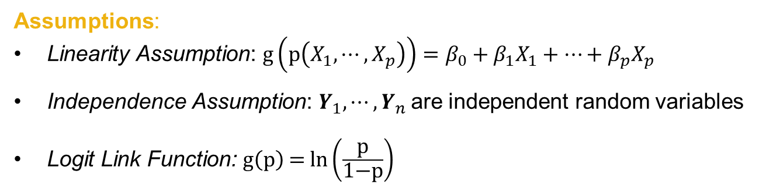
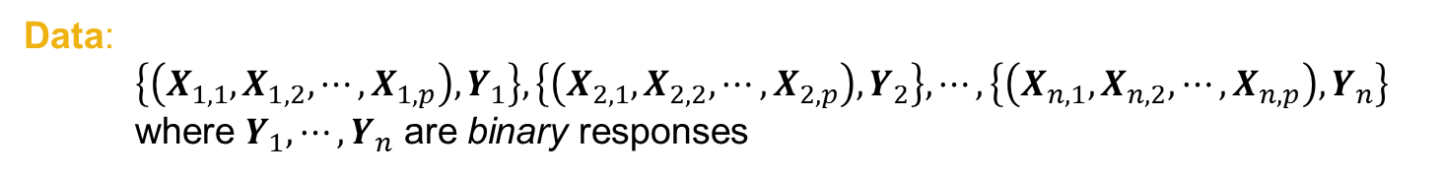
Logistic Regression Model
Data:
$$\left\{\left(X_{1,1},X_{1,2},⋯,X_{1,p}\right),Y_{1}\right\},\left\{\left(X_{2,1},X_{2,2},⋯,X_{2,p}\right),Y_{2}\right\},⋯,\left\{\left(X_{n,1},X_{n,2},⋯,X_{n,p}\right),Y_{n}\right\}$$
where $Y_{1},⋯,Y_{n}$ are binary responses
Assumptions:
Linearity Assumption: $g\left(p\left(X_{1},⋯,X_{p}\right)\right)=β_{0}+β_{1}X_{1}+⋯+β_{p}X_{p}$
Independence Assumption: $Y_{1},⋯,Y_{n}$are independent random variables
Logit Link Function: $\text{g}\left(\text{p}\right) \text{=} \text{ln}\left(\frac{\text{p}}{\text{1−}\text{p}}\right)$
There is no error term!
How to check the model assumptions?

Slide 4
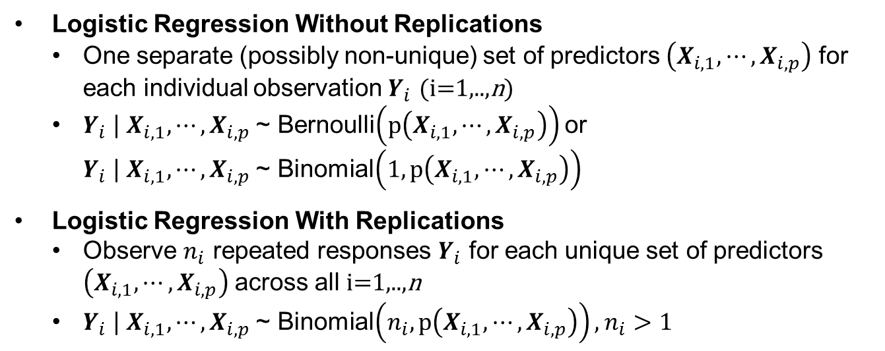

Residuals in Logistic Regression
Data:
$$\left\{\left(X_{1,1},X_{1,2},⋯,X_{1,p}\right),Y_{1}\right\},\left\{\left(X_{2,1},X_{2,2},⋯,X_{2,p}\right),Y_{2}\right\},⋯,\left\{\left(X_{n,1},X_{n,2},⋯,X_{n,p}\right),Y_{n}\right\}$$
where $Y_{1},⋯,Y_{n}$ are binary responses
Logistic Regression Without Replications
  One separate (possibly non-unique) set of predictors $\left(X_{i,1}, ⋯,X_{i,p}\right)$ for each individual observation $Y_{i}$ (i=1,..,n)
  $Y_{i}$ | $X_{i,1}, ⋯,X_{i,p}$~ Bernoulli$\left(p\left(X_{i,1}, ⋯,X_{i,p}\right)\right)$ or
  $Y_{i}$ | $X_{i,1}, ⋯,X_{i,p}$~ Binomial$\left(1, p\left(X_{i,1}, ⋯,X_{i,p}\right)\right)$
Logistic Regression With Replications
  Observe $n_{i}$ repeated responses $Y_{i}$ for each unique set of predictors $\left(X_{i,1}, ⋯,X_{i,p}\right)$across all i=1,..,n
  $Y_{i}$ | $X_{i,1}, ⋯,X_{i,p}$~ Binomial$\left(n_{i}, p\left(X_{i,1}, ⋯,X_{i,p}\right)\right),$ $n_{i}>1$

Slide 5
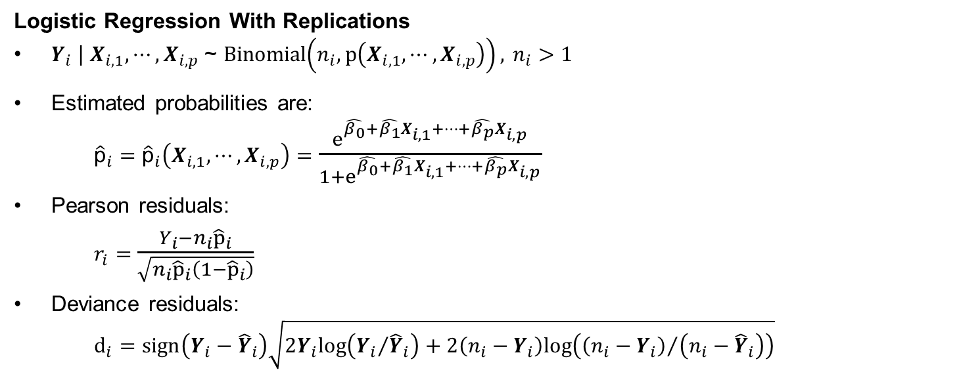
Residuals in Logistic Regression
Logistic Regression With Replications
$Y_{i}$ | $X_{i,1}, ⋯,X_{i,p}$~ Binomial$\left(n_{i}, p\left(X_{i,1}, ⋯,X_{i,p}\right)\right),$ $n_{i}>1$
Estimated probabilities are:
${\hat{\text{p}}}_{i}={\hat{\text{p}}}_{i}\left(X_{i,1}, ⋯,X_{i,p}\right)=$ $\frac{e^{\hat{β_{0}}+\hat{β_{1}}X_{i,1}+⋯+\hat{β_{p}}X_{i,p}}}{1+e^{\hat{β_{0}}+\hat{β_{1}}X_{i,1}+⋯+\hat{β_{p}}X_{i,p}}}$
Pearson residuals:
$r_{i}=$ $\frac{Y_{i}{−n}_{i}{\hat{p}}_{i}}{\sqrt{n_{i}{\hat{p}}_{i}\left({1−\hat{p}}_{i}\right)}}$
Deviance residuals:
$$d_{i}=sign\left(Y_{i}−{\hat{Y}}_{i}\right)\sqrt{2Y_{i}log\left({Y_{i}}/{{\hat{Y}}_{i}}\right)+2\left(n_{i}−Y_{i}\right)log\left({\left(n_{i}−Y_{i}\right)}/{\left(n_{i}−{\hat{Y}}_{i}\right)}\right)}$$

Slide 6
Residuals in Logistic Regression
Logistic Regression With Replications
$Y_{i}$ | $X_{i,1}, ⋯,X_{i,p}$~ Binomial$\left(n_{i}, p\left(X_{i,1}, ⋯,X_{i,p}\right)\right),$ $n_{i}>1$
Estimated probabilities are:
${\hat{\text{p}}}_{i}={\hat{\text{p}}}_{i}\left(X_{i,1}, ⋯,X_{i,p}\right)=$ $\frac{e^{\hat{β_{0}}+\hat{β_{1}}X_{i,1}+⋯+\hat{β_{p}}X_{i,p}}}{1+e^{\hat{β_{0}}+\hat{β_{1}}X_{i,1}+⋯+\hat{β_{p}}X_{i,p}}}$
Pearson residuals:
$r_{i}=$ $\frac{Y_{i}{−n}_{i}{\hat{p}}_{i}}{\sqrt{n_{i}{\hat{p}}_{i}\left({1−\hat{p}}_{i}\right)}}$
Deviance residuals:
$$d_{i}=sign\left(Y_{i}−{\hat{Y}}_{i}\right)\sqrt{2Y_{i}log\left({Y_{i}}/{{\hat{Y}}_{i}}\right)+2\left(n_{i}−Y_{i}\right)log\left({\left(n_{i}−Y_{i}\right)}/{\left(n_{i}−{\hat{Y}}_{i}\right)}\right)}$$
Pearson’s residuals follow directly a normal approximation to a binomial, hence approximately N(0,1).
The deviance residuals are the signed square root of the log-likelihood evaluated at the saturated model vs. the fitted model, thus approximately N(0,1) if the model is a good fit.

Slide 7
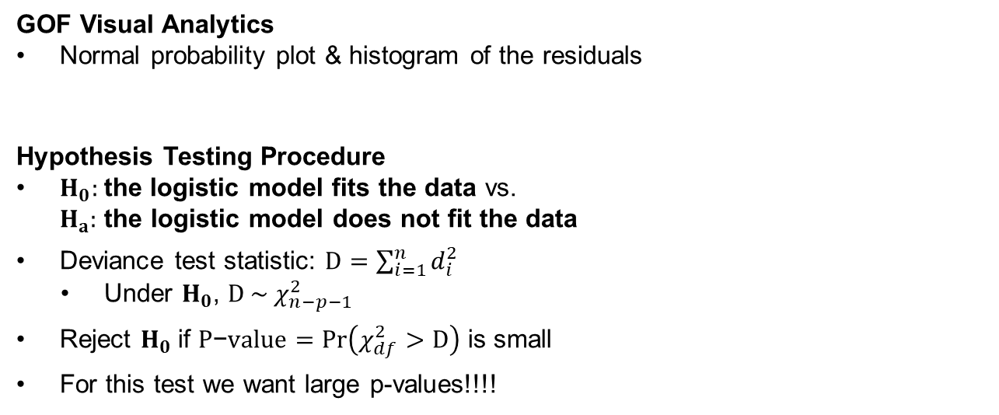
Model Goodness of Fit
GOF Visual Analytics
Normal probability plot & histogram of the residuals
Hypothesis Testing Procedure
$H_{0}:$the logistic model fits the data vs.
$H_{a}:$ the logistic model does not fit the data
Deviance test statistic: $D=\sum_{i=1}^{n}{d_{i}^{2}}$
    Under $H_{0}$, ${D \sim χ}_{n−p−1}^{2}$
  Reject $H_{0}$if $P\text{−}value=Pr\left(χ_{df}^{2}>D\right)$ is small
  For this test we want large p-values!!!!

Slide 8
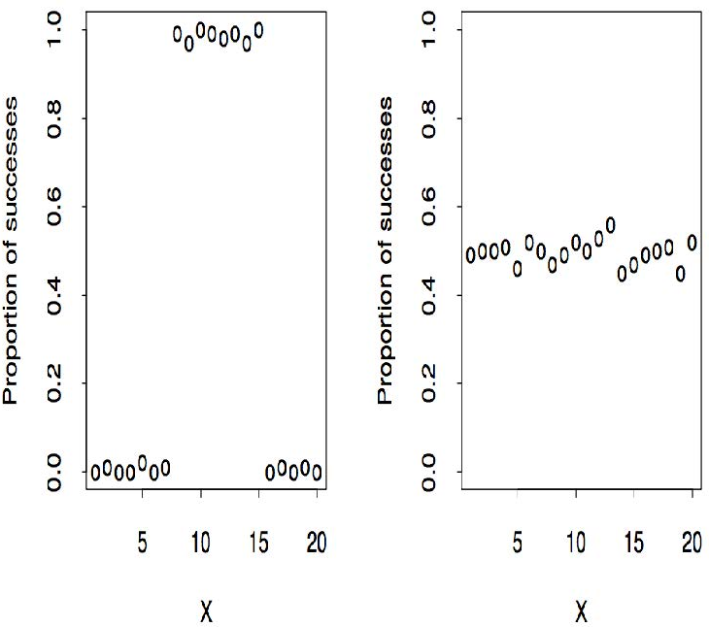
Goodness of Fit vs. Predictive Power
Goodness of fit: Model assumptions hold
  For example, does the S-shape logit function fit the data?
Predictive Power: The predicting variables predict the data
  Even if the one or more assumptions do not hold
While the logistic model is a sensible one for probabilities, it is not necessarily appropriate for any particular data set. That does not mean that the predicting variables are not good predictors of the probability of success.

Slide 9
What If No Goodness of Fit?
Add predicting variables
Transform predicting variables to improve linearity
Identify unusual observations (outliers, leverage points)
The binomial distribution may not be appropriate
  Overdispersion: The variability of the probability estimates is larger than would be implied by a binomial random variable
  Correlation in the observed responses
  Heterogeneity in the success probabilities that hasn’t been modeled
  Logit function may not fit data
  Other S-shape functions
    probit, complementary log-log (c-log-log)

Slide 10
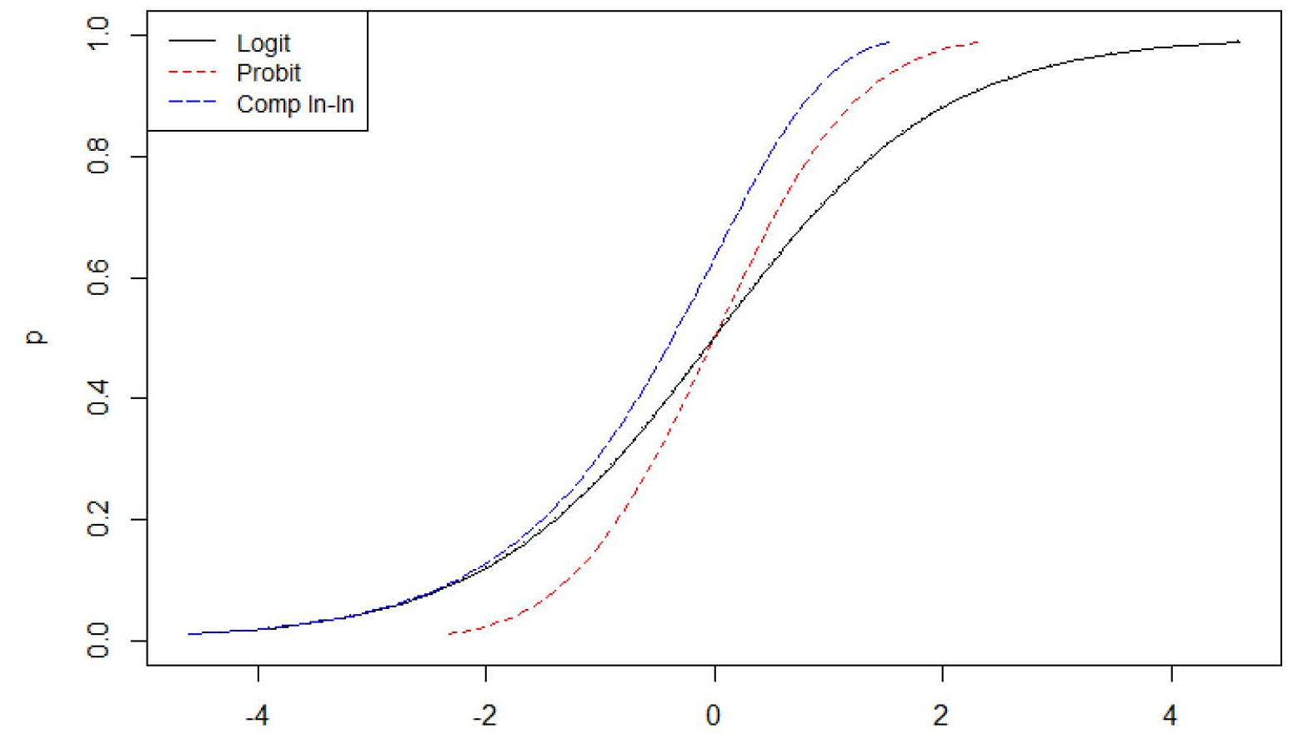
What If No Goodness of Fit?
Add predicting variables
Transform predicting variables to improve linearity
Identify unusual observations (outliers, leverage points)
The binomial distribution may not be appropriate
  Overdispersion: The variability of the probability estimates is larger than would be implied by a binomial random variable
  Correlation in the observed responses
  Heterogeneity in the success probabilities that hasn’t been modeled
  Logit function may not fit data
  Other S-shape functions
    probit, complementary log-log (c-log-log)

Slide 11
What If No Goodness of Fit?
Add predicting variables
Transform predicting variables to improve linearity
Identify unusual observations (outliers, leverage points)
The binomial distribution may not be appropriate
  Overdispersion: The variability of the probability estimates is larger than would be implied by a binomial random variable
  Correlation in the observed responses
  Heterogeneity in the success probabilities that hasn’t been modeled
  Logit function may not fit data
  Other S-shape functions
    probit, complementary log-log (c-log-log)
Why logistic regression?
Logit link function is the canonical link function
Ease of interpretation of the regression coefficients

Slide 12

Summary

